Slide 1
OBESITA’ e SISTEMA IMMUNITARIO
Giovanni merola
Asl napoli2 nord- Ospedale san giovanni di dio - frattamaggiore (na)

Slide 2
CONFLITTO DI INTERESSI
[ x ] nessun conflitto di interessi da riportare
[ ] ho i seguenti conflitti di interessi:__________________

Slide 3
CASISTICA 2017-2025

Slide 4
IL NUOVO LESSICO DEL CHIRURGO METABOLICO
OBESITA’: patologia CRONICA – RECIDIVANTE – EVOLUTIVA - PATOLOGIA INFIAMMATORIA e non più stato di ipernutrizione
Associato ad aumento del peso del BMI della circonferenza vita.
Il contributo degli altri specialisti (ENDOCRINOLOGI/IMMUNOLOGI)
ADIPOKINE: famiglia (circa 600) di ormoni/citochine prodotte dal tessuto adiposo (organo endocrino). Giocano un ruolo cruciale sulla regolazione del sistema immunitario, sul metabolismo, funzione cardiovalscolare e patologie neoplastiche.
  Adipokine prodotte dal grasso bruno: fibroblast growth factor 21 (FGF21), bone morphogenetic protein 7 (BMP-7), vascular endothelial growth factor A (VEGF-A), irisin, neuregulin 4 (NRG4), nesfatin-1, meteorin-like protein (METRNL), chemerin, IL-6, interleukin-8 (IL-8), interleukin-10 (IL-10)
  Adipokine prodotte dal grasso bianco: leptin, adipsin, adiponectin, omentin, tumor necrosis factor-alpha (TNF-), interleukin-6 (IL-6), monocyte chemoattractant protein-1 (MCP-1), plasminogen activator inhibitor-1 (PAI-1), resistin, visfatin, and retinol-binding protein 4 (RBP4)

Slide 5
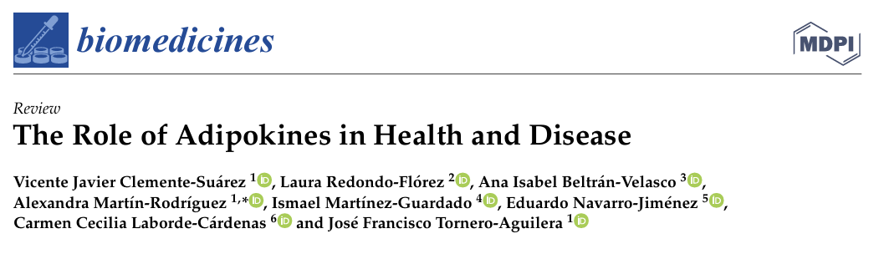
ADIPOKINE
PROINFIAMMATORIE
ANTI-INFIAMMATORIE
LEPTINA: aumenta direttamente la produzione di IL-6, IL12, IL-18, and TNF , IL-8, and the lipid intermediaries PGE, cysteinyl leukotrienes (cysLTs), e leukotriene B4 (LTB4) in peripheral blood monocytes
RESISTINA: studi su animale hanno evidenziato che l’aumento di resistina è positivamente associato ad una rezione pro infiammatoria
VISFATINA
…
ADIPONECTINA
OMENTINA: sopprime la produzione di TNFalfa e COX2
CTRP3 blocca l’attivazione di TLR4
…

Slide 6
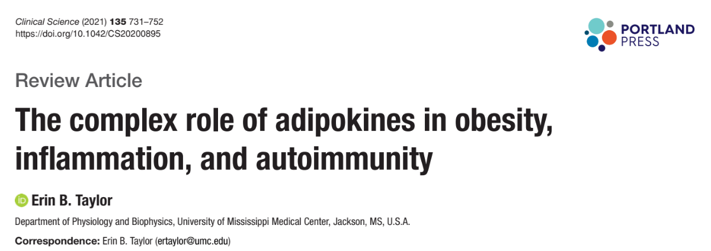

Slide 7
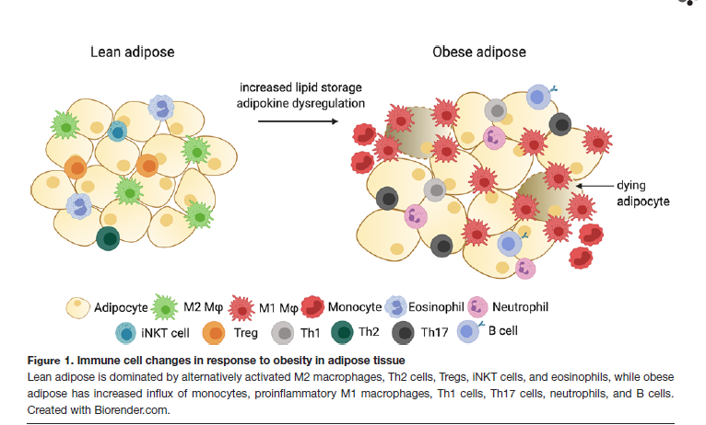

Slide 8
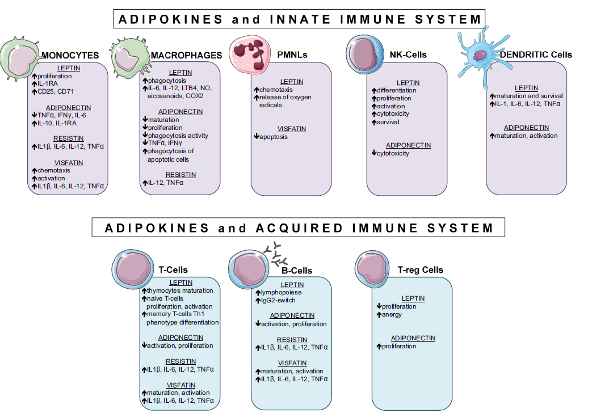

Slide 9
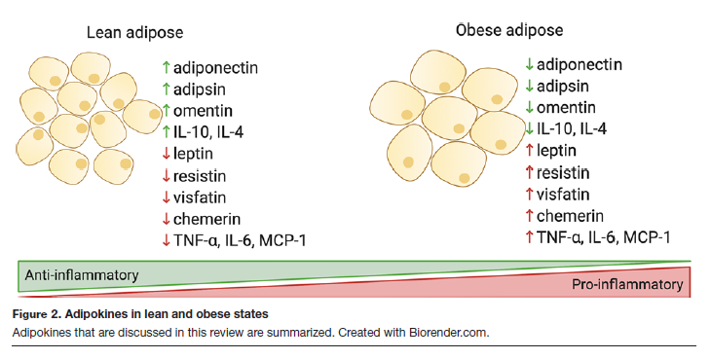
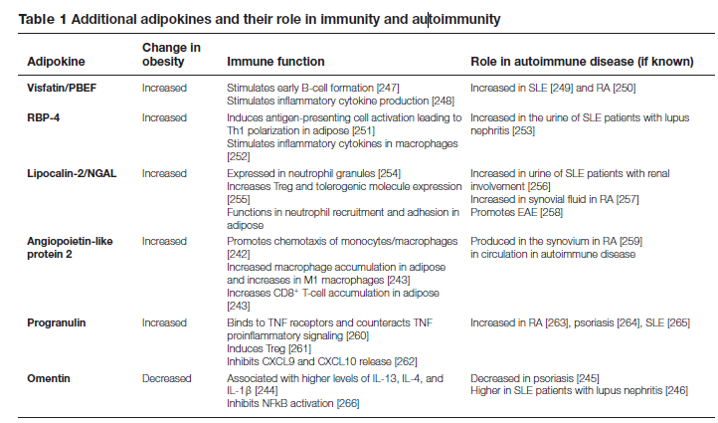

Slide 10
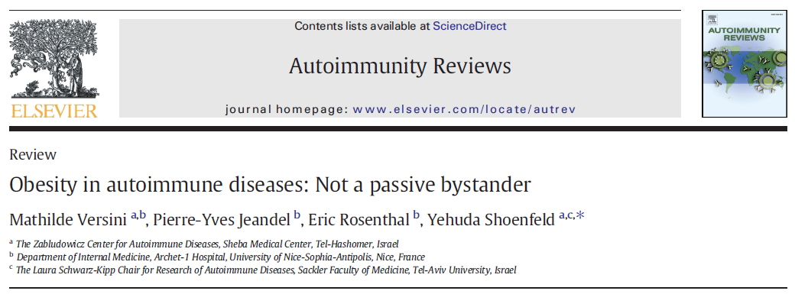
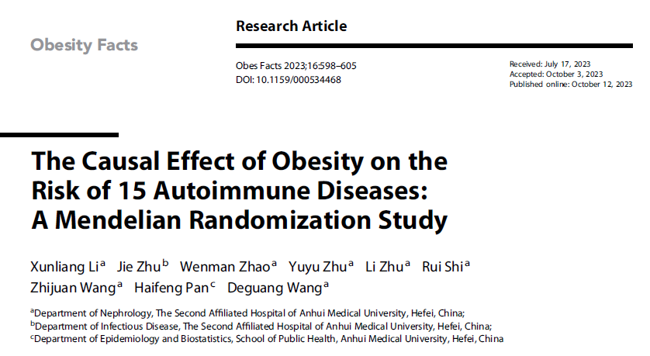

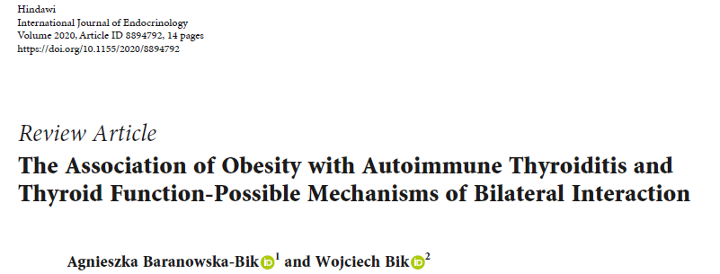
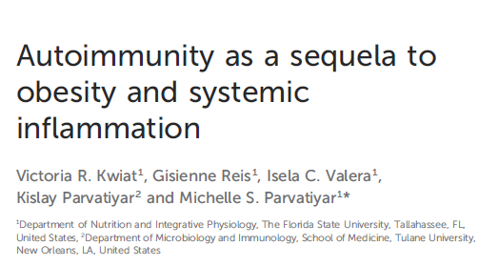
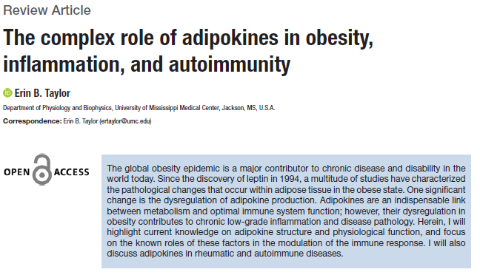
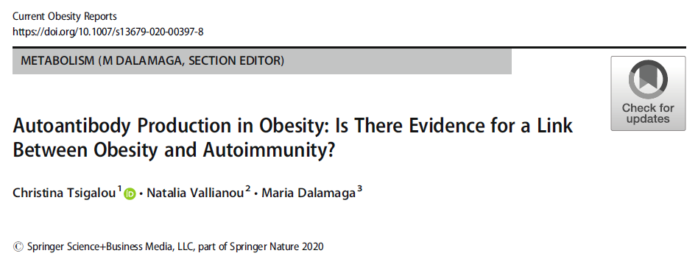

Slide 11
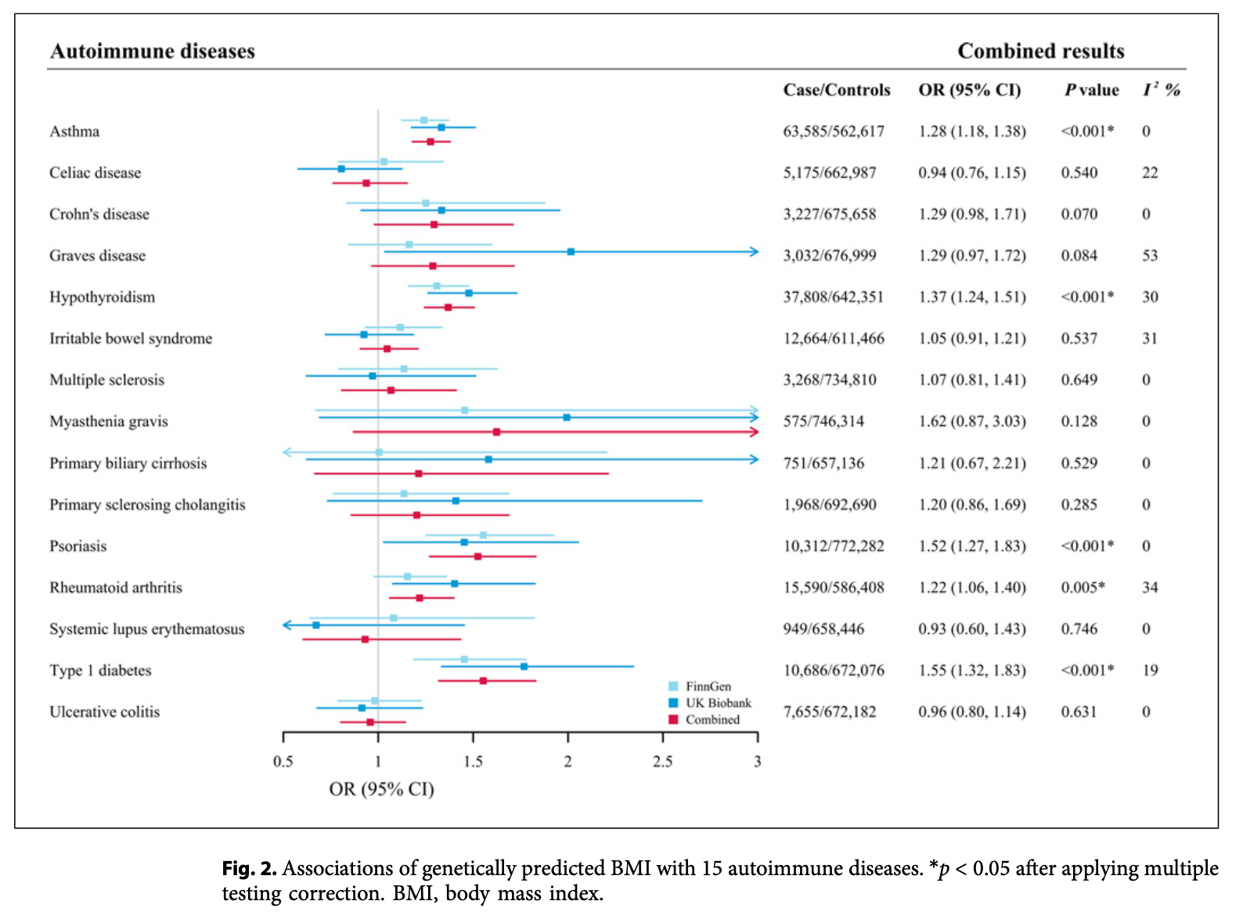
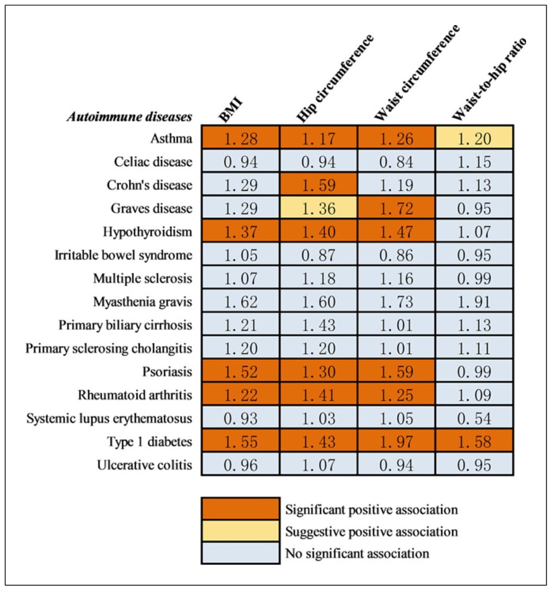
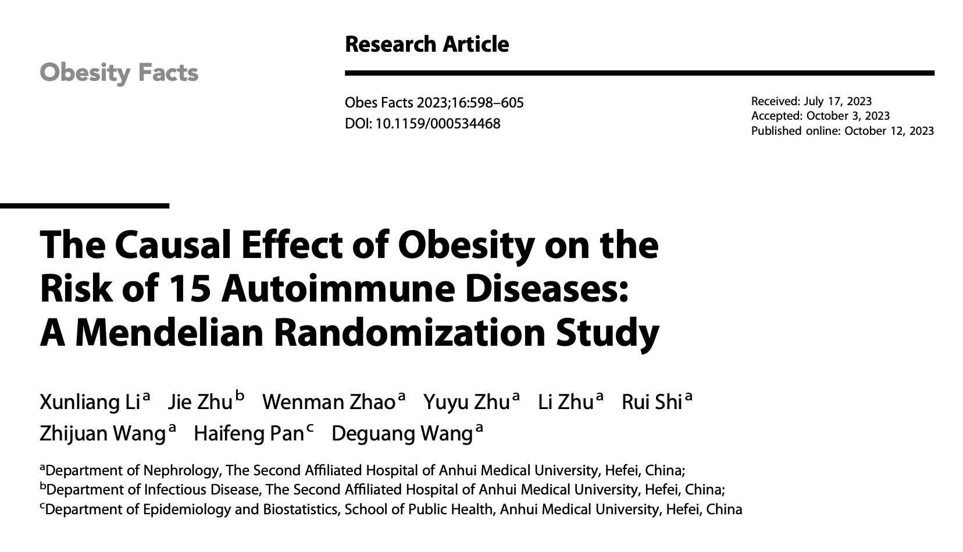

Slide 12
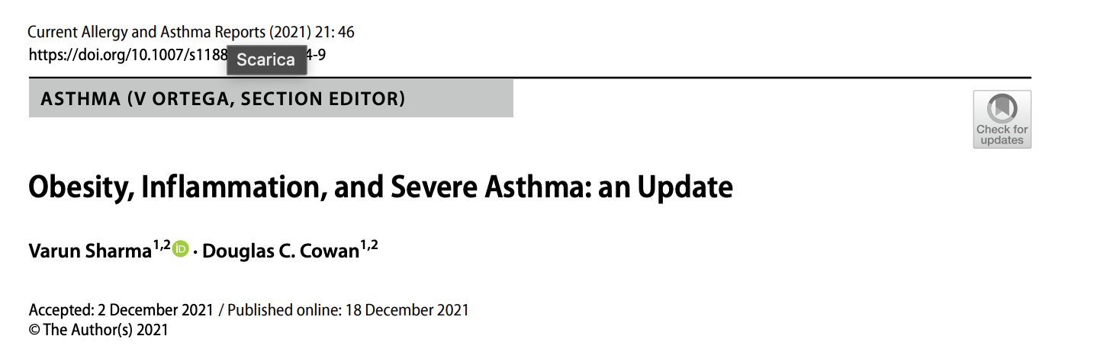
A recent European prospective study (n = 202) reported an additive effect of asthma and obesity on increased release of pro-inflammatory mediators and airway inflammation as well as modification of the gut, nasal, oral, and lung microbiome, intimately linked with inflammation [42∙]. Use of SPECT/CT scanning in obese-asthma has recently shown increased lung eosinophil uptake compared to healthy BMI counterparts further emphasising the impact of obesity on airway inflammation [44]. The presence of dietary polyunsaturated and saturated fatty acids increase release of inflammatory cytokines during respiratory tract infection which may enhance airway inflammation and therefore impact severity of asthma exacerbation [45].

Slide 13
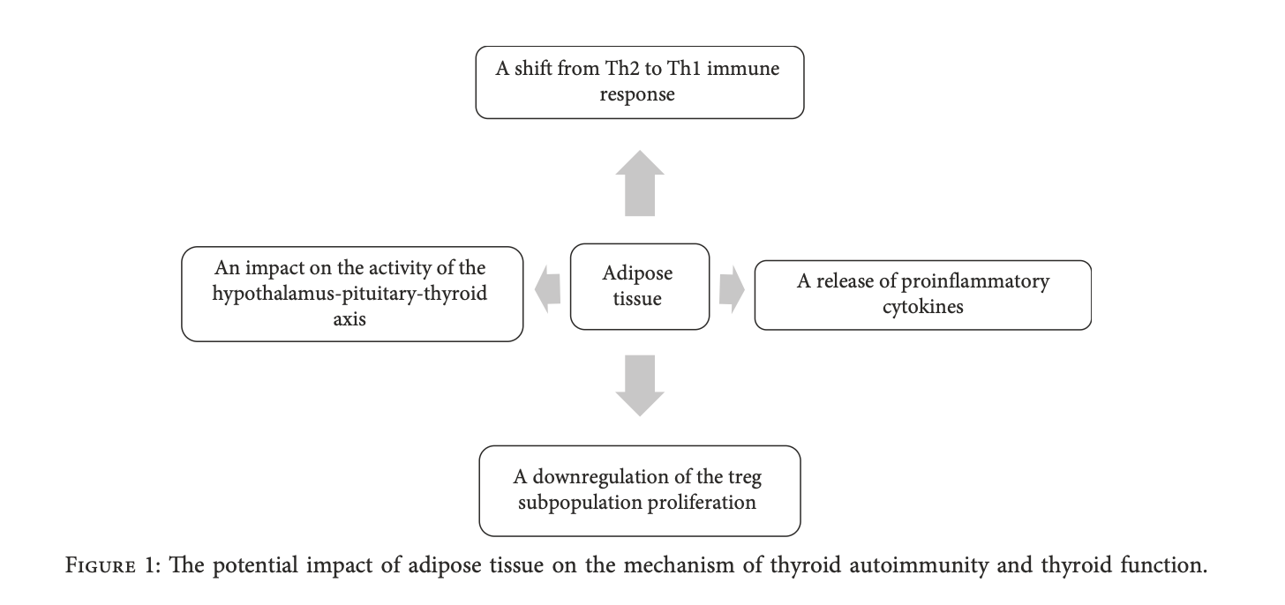
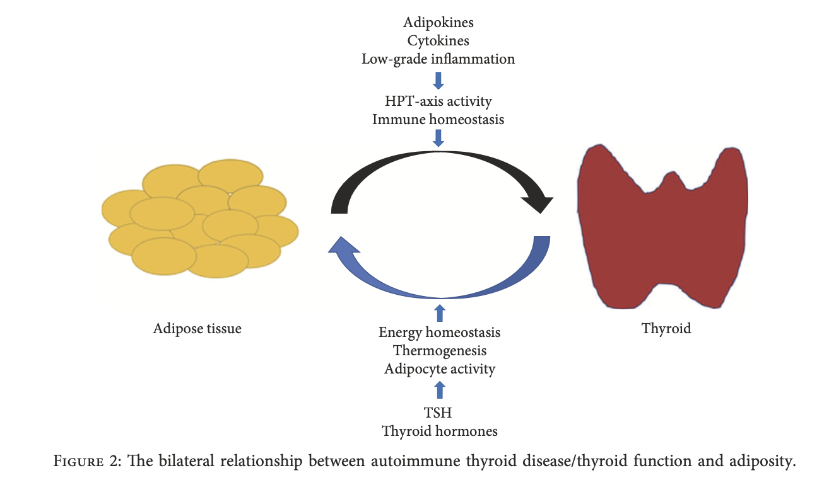
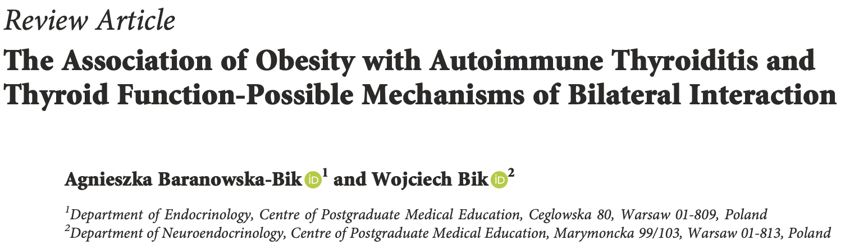

Slide 14
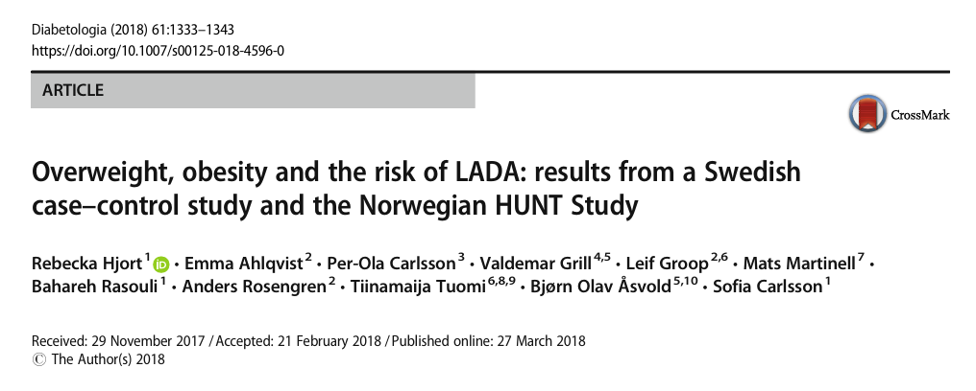
We confirm the strong association previously reported of overweight and obesity with type 2 diabetes [1]. In addition, we confirm that the combination of overweight and FHD dramatically increases the risk of type 2 diabetes [21] and show, for the first time, that the risk of LADA increases substantially in individuals with Family History of Diabetes and overweight/obesity

Slide 15
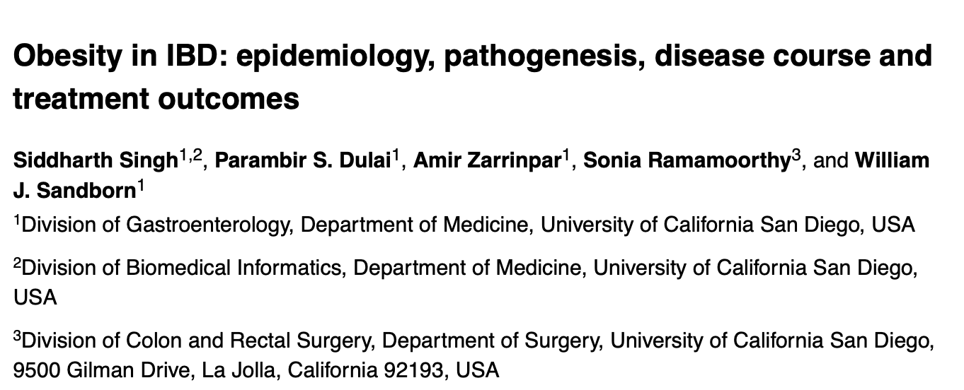
Although from a pathophysiological perspective, obesity, and in particular visceral adiposity, seems to promote intestinal inflammation, epidemiological studies implicating obesity in the development of IBD are limited. Understanding of the effects of obesity on cross-sectional disease severity and development of disease complications is incomplete, with studies conducted to date (with flawed designs and inherent limitations) showing conflicting results.
On the basis of pharmacokinetic data, obesity seems to promote rapid clearance of biologic agents, regardless of drug dose. The effect of obesity on response to therapy remains to be studied, though data from other autoimmune diseases suggests that obesity is an independent predictor of poor response to medical therapy. This association provides an opportunity for using treatment directed towards obesity, either through lifestyle, pharmacological or endoscopic interventions, as adjunctive therapy in patients with IBD who are obese.

Slide 16
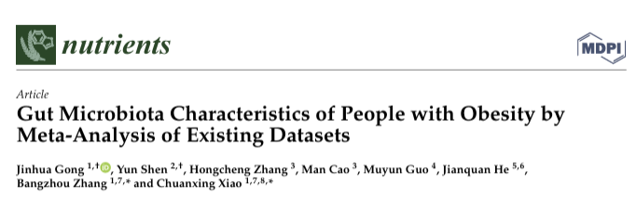
Meanwhile, the dysbiosis of gut microbiota leads to the increase of endotoxin in the circulating system of the host, and induces chronic and low-level inflammation, leading to obesity and insulin resistance

Slide 17
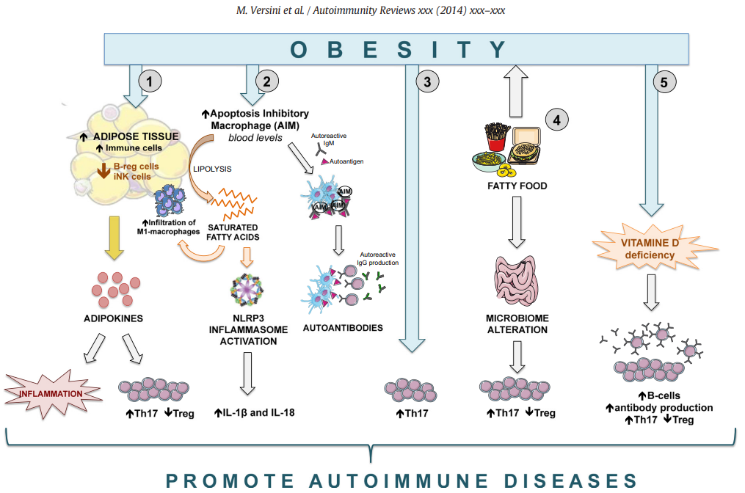
RIASSUMENDO

Slide 18
Grazie

